Slide 1
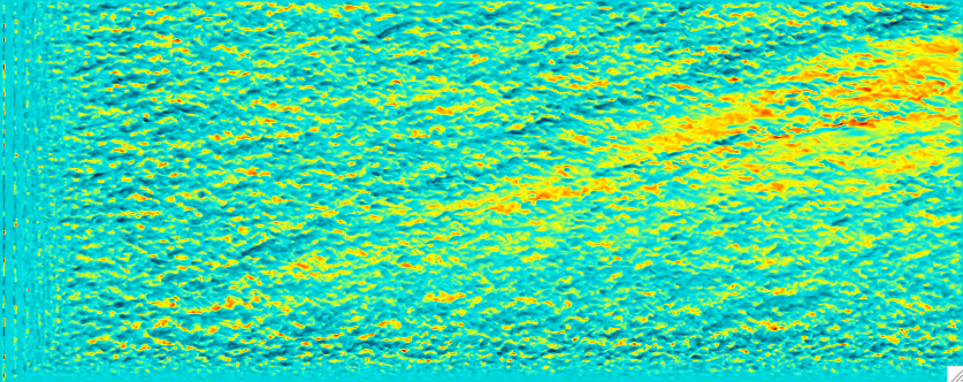
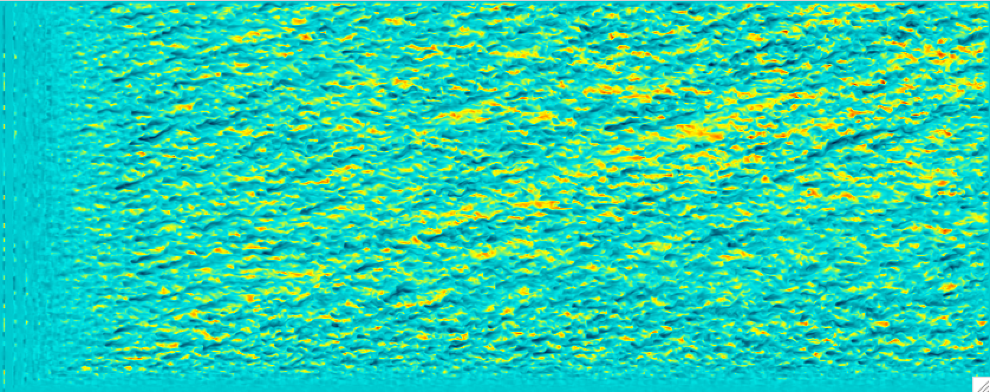
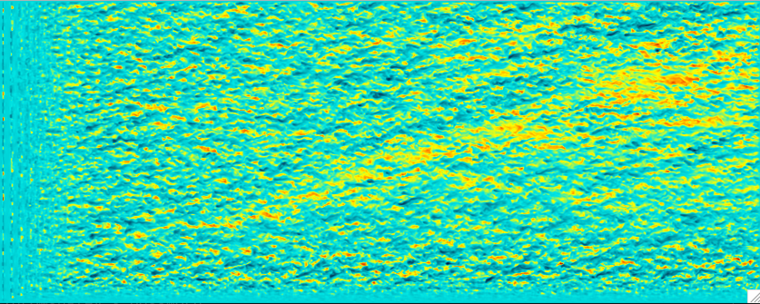
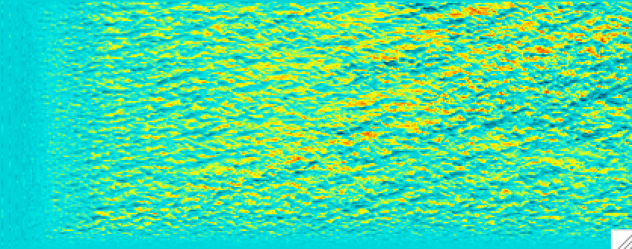
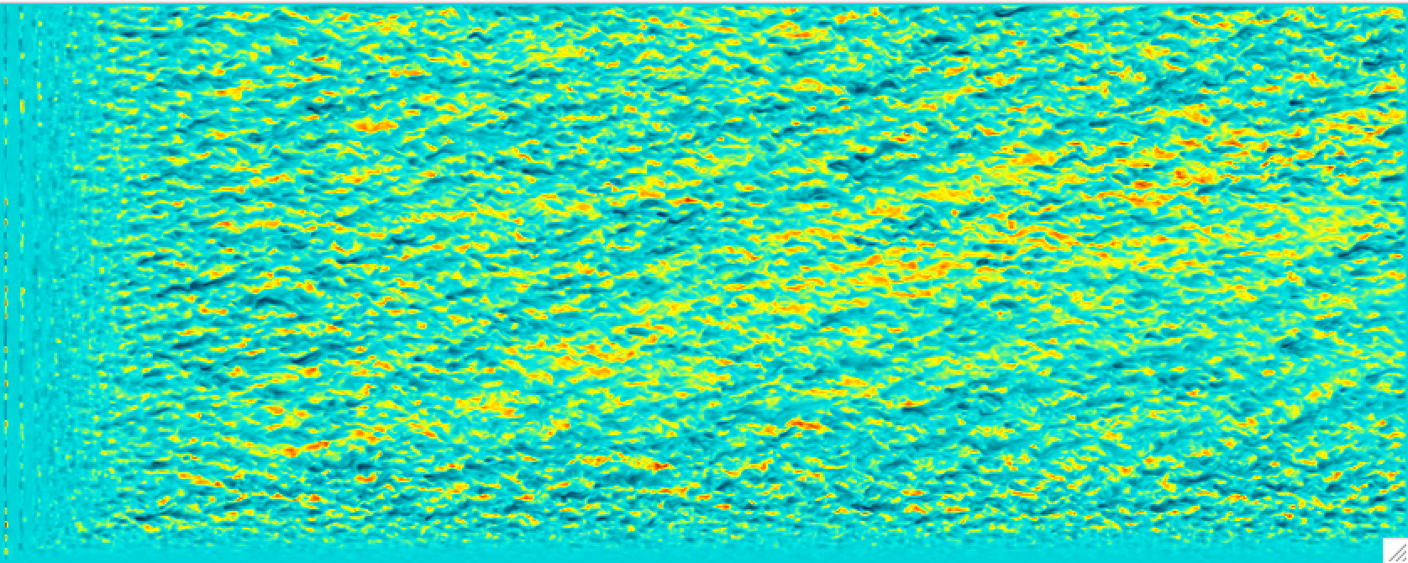

Z = 240 m
9-1-0: 0.5
9-1-1: 0.25
9-1-5: 0.40
9-1-3: 0.125
9-1-4: 0.35

Slide 2
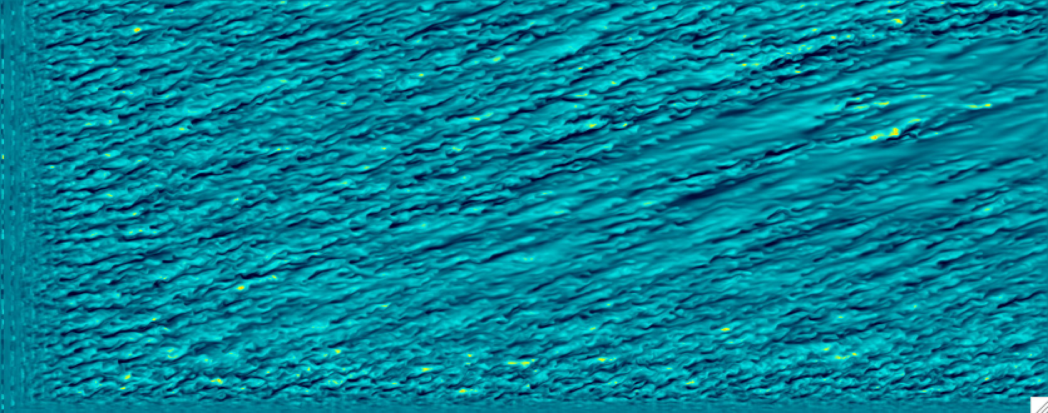
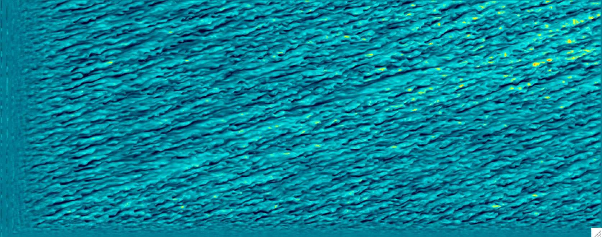
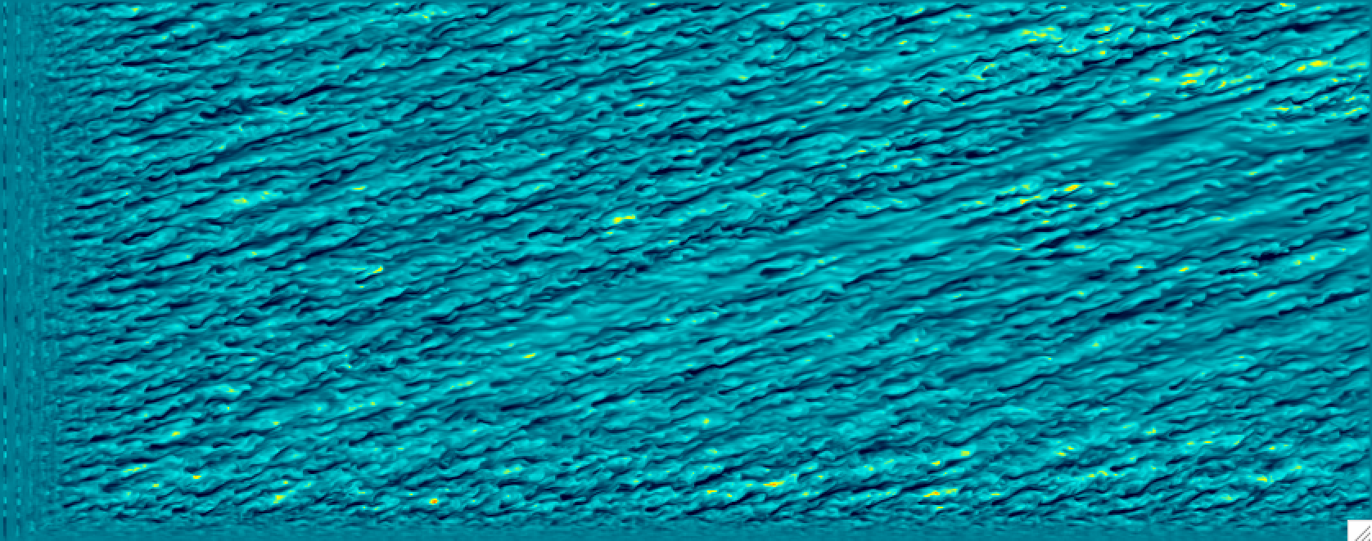

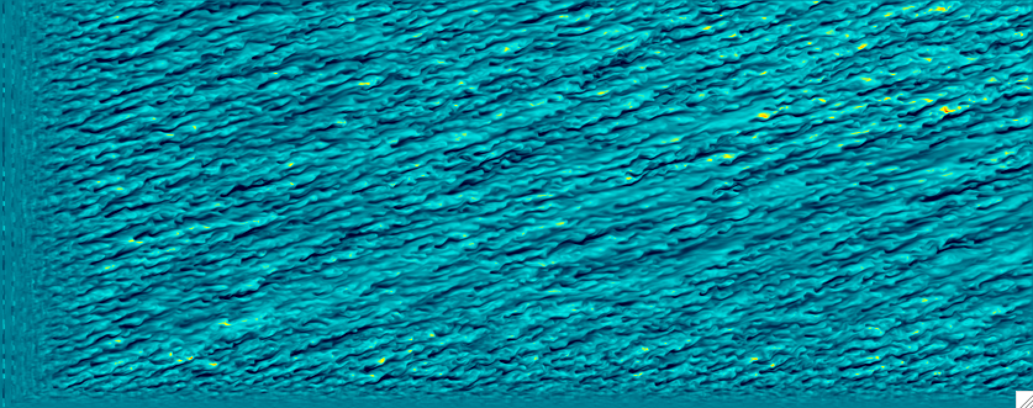
Z = 100 m
9-1-0: 0.5
9-1-1: 0.25
9-1-5: 0.40
9-1-3: 0.125
9-1-4: 0.35

Slide 3
9-1-0: 0.5
9-1-5: 0.40
9-1-4: 0.35
9-1-1: 0.25
9-1-3: 0.125

